Slide 1

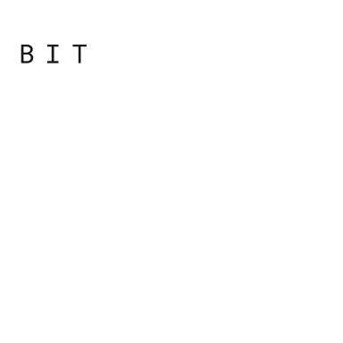
Programming
Principles
with JavaScript

Slide 2
Numbers

Slide 3

Numbers
The simplest number is an integer.
> var n = 1;
> typeof n;
"number"

Slide 4
Octal and Hexadecimal Numbers
When a number starts with a 0, it's considered an octal number.
e.g. the octal 0377 is the decimal 255
> var n3 = 0377;
> typeof n3;
"number"
> n3;
255

Slide 5
Octal and Hexadecimal Numbers
In JavaScript, you put 0x before a hexadecimal value (also called hex for short):
> var n4 = 0x00;
> typeof n4;
"number"
> n4;
0

Slide 6
Exponent Literals
1e1 (also written as 1e+1 or 1E1 or 1E+1) represents the number one with one zero after it or 10
> 1e1; // 1e+1;
10
> 2e+3;
2000
> typeof 2e+3;
"number"

Slide 7
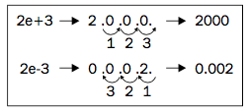
Exponent Literals
2e+3 means moving the decimal point three digits to the right of the number 2. There's also 2e-3, meaning you move the decimal point three digits to the left of the number 2
> 2e-3;
0.002
> 123.456E-3;
0.123456
> typeof 2e-3;
"number"

Slide 8
Infinity
There is a special value in JavaScript called Infinity. It represents a number too big for JavaScript to handle
> 1e309;
Infinity = NUMBER (NaN = number)
Dividing by zero gives you infinity
> var a = 6 / 0;
> a;
Infinity

Slide 9
Infinity
When you sum Infinity and minus Infinity, you don't get 0, but something that is called NaN (Not a Number)
> Infinity – Infinity;
NaN
Any other arithmetic operation with Infinity as one of the operands gives you Infinity

Slide 10
NaN
It turns out that despite its name, "Not a Number", NaN is a special value that is also a number
You get NaN when you try to perform an operation that assumes numbers, but the operation fails
> var a = 10 * "f";
> a;
NaN

Slide 11
NaN
NaN is contagious, so if you have even one NaN in your arithmetic operation, the whole result goes down the drain
> 1 + 2 + NaN;
NaN

Slide 12
Strings

Slide 13
Strings
A string is a sequence of characters used to represent text
Any value placed between single or double quotes is considered a string
This means that 1 is a number, but "1" is a string (“I’don’t know”)
Nothing in quotes “” is still a string (an empty string)

Slide 14
Strings
If you use the plus sign with strings, this is a string concatenation operation, and it returns the two strings glued together
> var s1 = "web";
> var s2 = "site";
> var s = s1 + s2;
> s
> “website”

Slide 15
Strings
The dual purpose of the + operator is a source of errors
If you intend to concatenate strings, it's always best to make sure that all of the operands are strings
Same applies for addition; if you intend to add numbers, make sure the operands are numbers

Slide 16
Special Strings
\ is the escape character
When you want to have quotes inside your string, you escape them so that JavaScript doesn't think they mean the end of the string
> var s = 'I don\'t know';
If you want to have an actual backslash in the string, escape it with another backslash \\.

Slide 17
Special Strings
\n End of line.
> var s = '\n1\n2\n3\n';
\t Tab
> var s = "1\t2";
\u followed by a character code allows you to use Unicode. > "\u0421\u0442\u043E"

Slide 18
Summary

Slide 19
Summary
Primitive data types are one of the basic building blocks of a JavaScript program: typeof
• Number
• String
• Boolean
• Undefined
• Null

Slide 20
Summary
You also know quite a few operators:
• Arithmetic operators: +, -, *, /, %
• Increment operators: ++ and --
• Assignment operators: =, +=, -=, *=, /=, %=
Expected outcome – kad zadamo var i ocekujemo rezultat
• Special operators: typeof
• Logical operators: &&, ||, !
AND OR NOT
• Comparison operators:
==, ===, !=,(≠)!==, <, >, >=, <=

Slide 21
Comments

Slide 22
Comments
Inside your JavaScript program, you can put comments
Ignored by the JavaScript engine and don't have any effect on how the program works
They help when you or someone else revisits code

Slide 23
Comments
Two types of comments are allowed:
Single line comments start with // and end at the end of the line.
Multiline comments start with /* and end with */ in the same line or any subsequent line
Note that any code in between the comment start and the comment end is ignored

Slide 24
Comments
// beginning of the line
var a = 1; // anywhere in the line
/* multi-line comment in a single line */
/*
comment that spans across several
lines
*/

Slide 25

Practical
Notes:
Starting with the bootcamp
Hoping to catch the wave and achieve much more

Slide 26
What is the result of executing each of these lines in the console? Why?

Slide 27
var a; typeof a; - a undefined, string
var s = '1s'; s++; - NaN
!!"false"; - true
!!undefined; - false
typeof -Infinity; - string (number = text)
10 % "0"; - NaN
undefined == null; true
false === ""; false
typeof "2E+2"; - string
a = 3e+3; a++; - number 3.001

Slide 28

Notes:
http://eloquentjavascript.net/01_values.html

